Slide 1
Preventing Suicide

Slide 2
What Is Suicide?
Suicide is the action of killing oneself intentionally, which means you killed yourself. An example of suicide is hanging yourself. Another example of suicide is shooting yourself.
There are many other examples such as:
Jumping off a building.
Taking a multiple number of pills.
Slicing your own throat.

Slide 3
Why Do People Commit Suicide?
People that commit suicide probably had a sort of problems. Some people do it just because of self-hatred(depression).
Other Reasons:
Bullying situations.
Family problems.
Relationship problems.

Slide 4
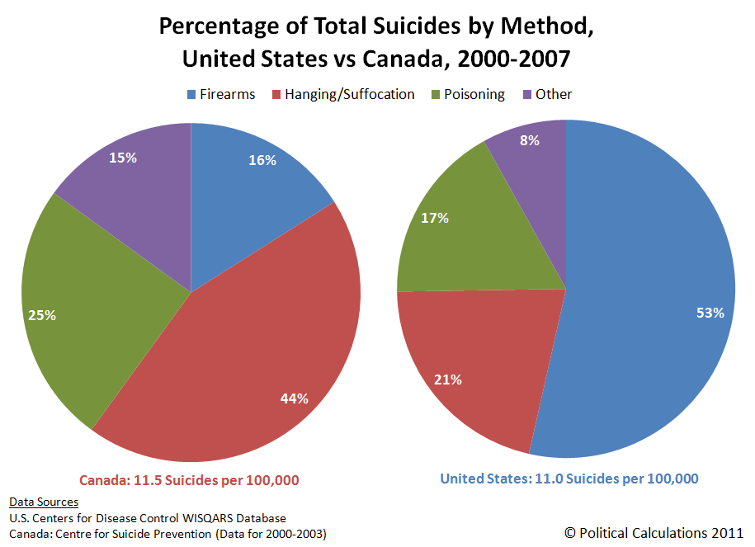
Percentage Of Suicide Rate
This is the suicide rate taken place in the U.S. and Canada:

Slide 5
Teenager Suicide
If most people commit suicide, then who does it out of age. It’s most committed by teenagers. Teenagers go through it most often because in that age you’re experiencing everything that you through from a little kid to an adult.

Slide 6
Warning Signs
Before the people that went through suicide, they had signs to tell themselves to do. That’s why there is the word warning in warning signs. There are many severe waning signs that you will get to.
Which Includes:
Thinking about it often.
Strong depression.
Going mad.

Slide 7
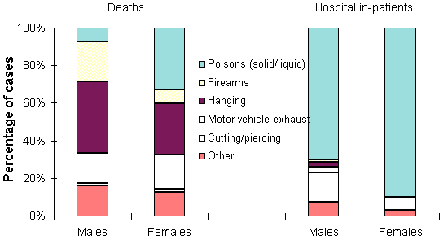
Males Or Females?
Tests show that males commit suicide worldwide three or four more times than females.

Slide 8
How To Prevent Suicide
There are many easy ways to prevent suicide. You really think about your life and how good to keep it. You can also talk to somebody or a close friend. You can participate in an activity that is entertaining or fun for you. These answers will help you put yourself back together.

Slide 9
ENJOY YOUR LIFE!
Just enjoy life. Go to church; marry somebody; get into sports.

Slide 10
Thank You For Your Time

